Slide 1
Update Xenxible Project Device Identifier
Syaziyah

Slide 2
MACHINE LEARNING PIPELINE
INPUT
(Customer, Project, Device ID)
UPDATE ON (16.04.2026)
1
ML MODEL
RETRIVE
[new_equipment.pkl]
XGBoost
NEW LIST OF EQUIPMENT
3
Cluster
Section
UNKNOWN
= Assign by User
RESULT OUTPUT
(Customer, Project, Device ID, Section, Cluster)
2
Process flow
(1) Input - Model – Result Output – Update & Save Model
(2) Input - Model - Output (UNKNOWN) - Assign by user – New Equipment Data
- Model – Update & Save Model
(3) New Equipment Data - Model - Update & Save Model
UPDATE & SAVE MODEL

Slide 3
THANK YOU

Slide 4
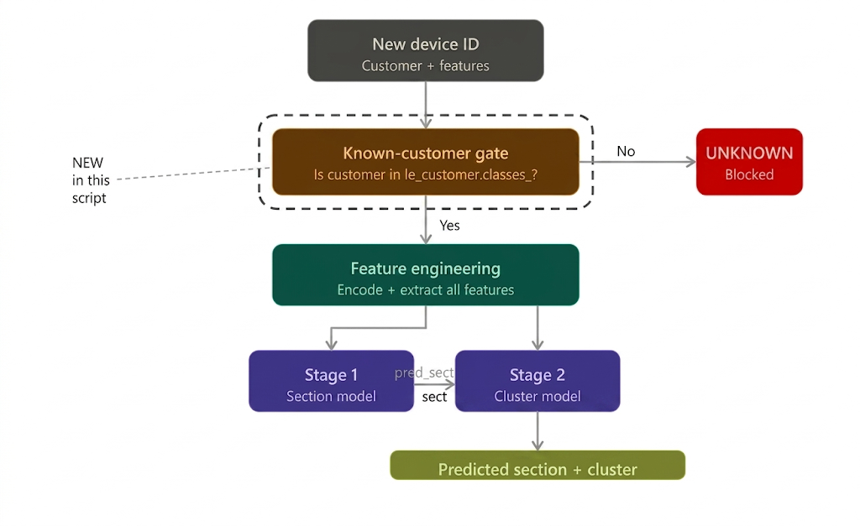

Slide 5
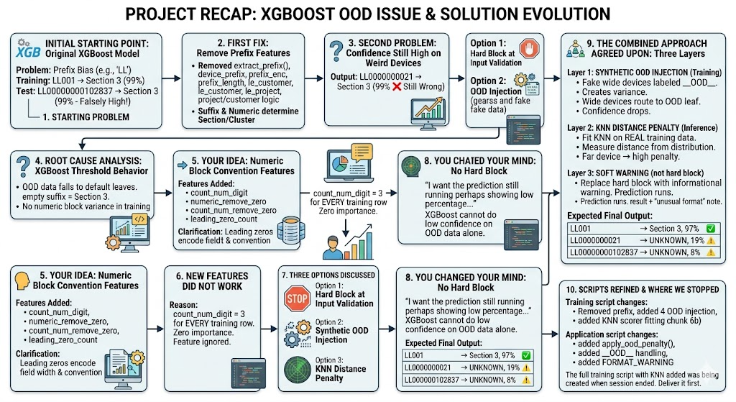

Slide 6
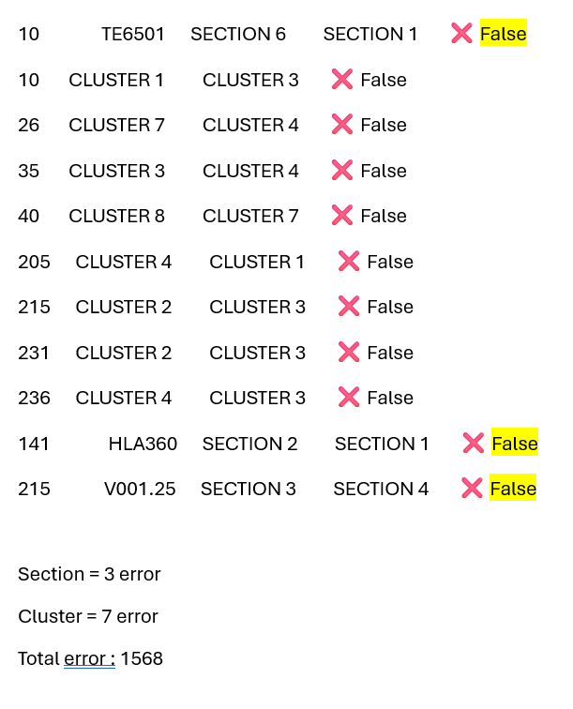

Slide 7
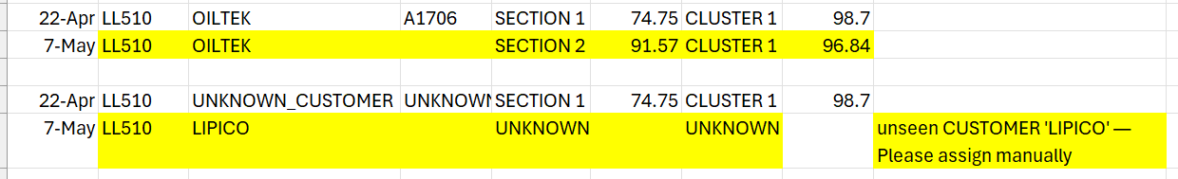

Slide 8
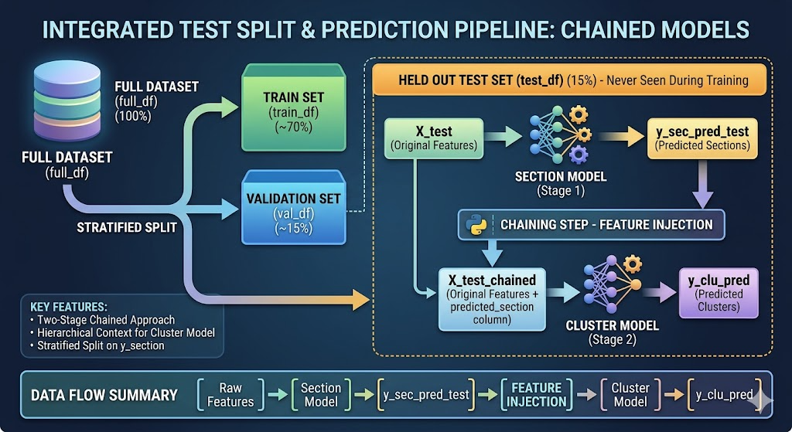

Slide 9
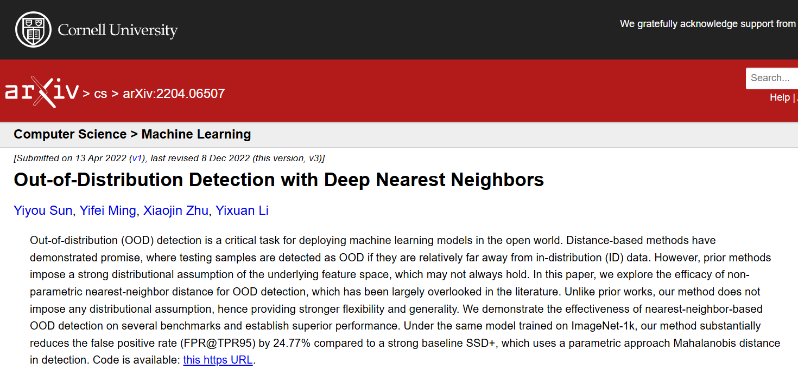
https://arxiv.org/abs/2204.06507

Slide 10
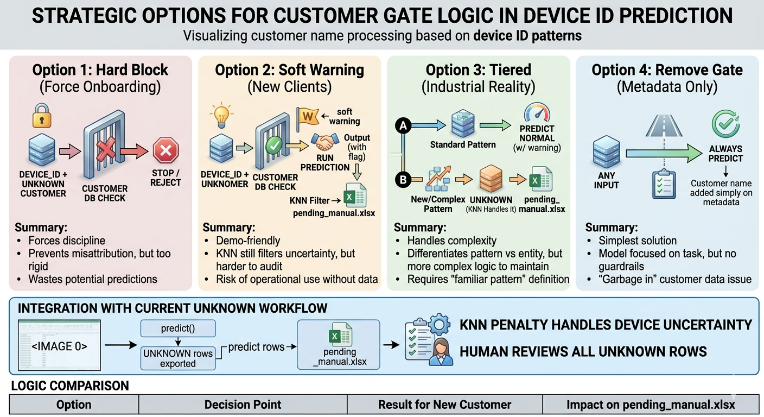

Slide 11
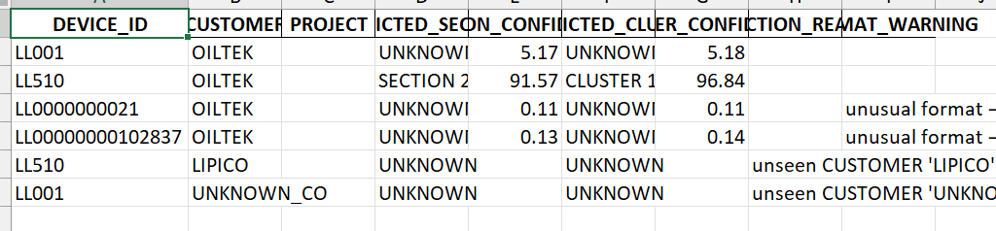
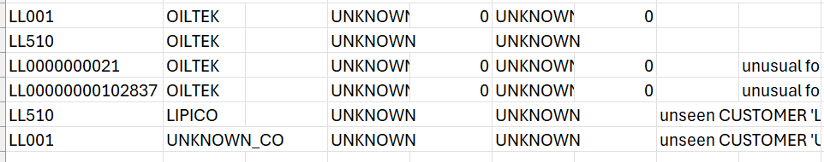
95% ood threshold
99% ood threshold

Slide 12
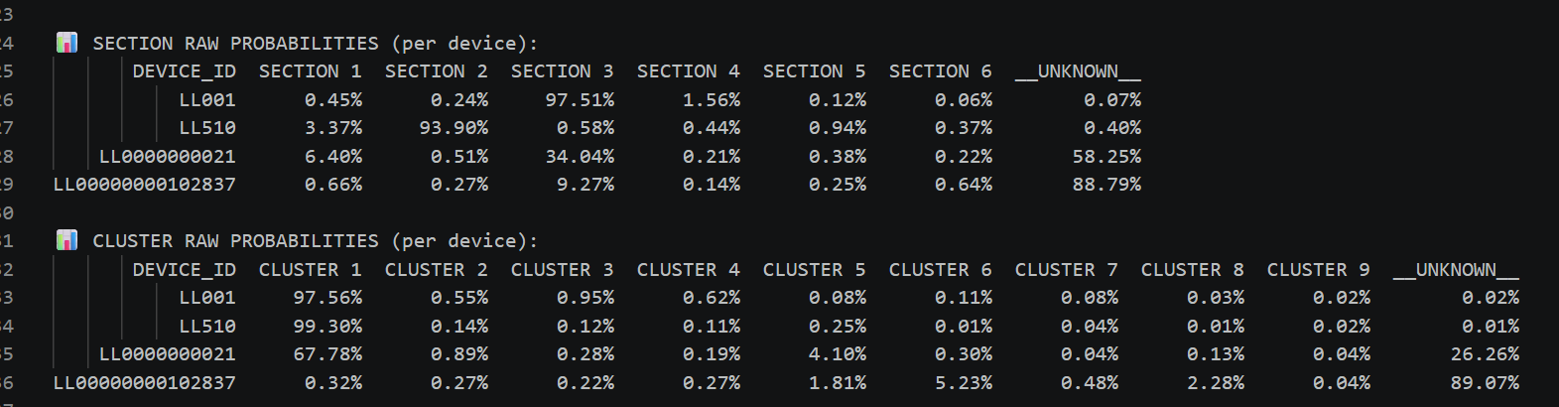

Slide 13
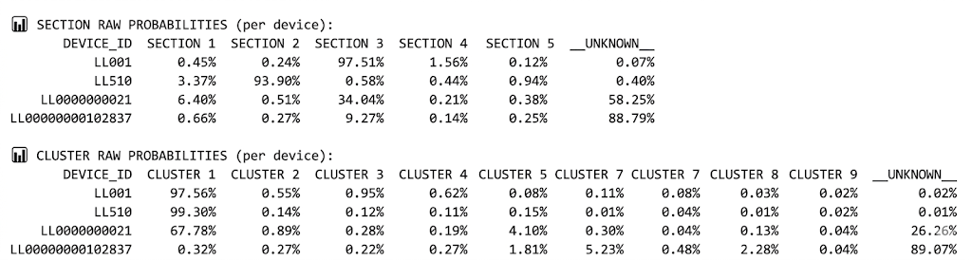

Slide 14
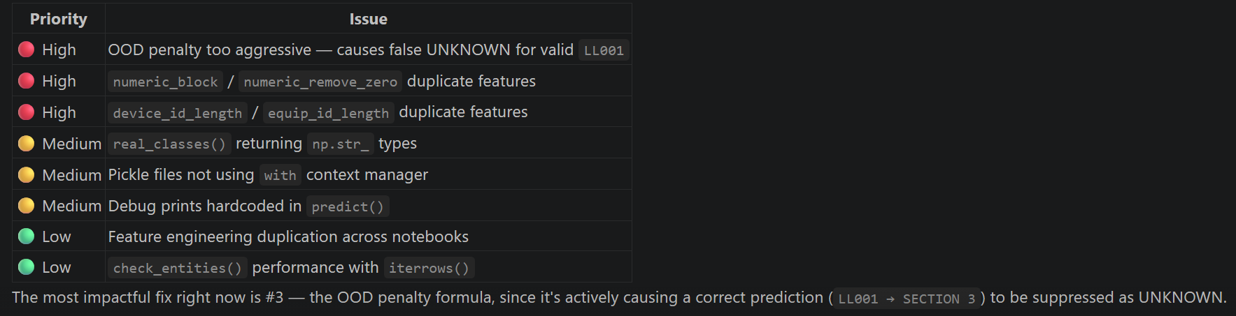

Slide 15
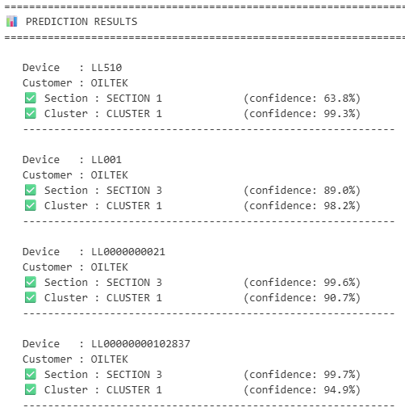
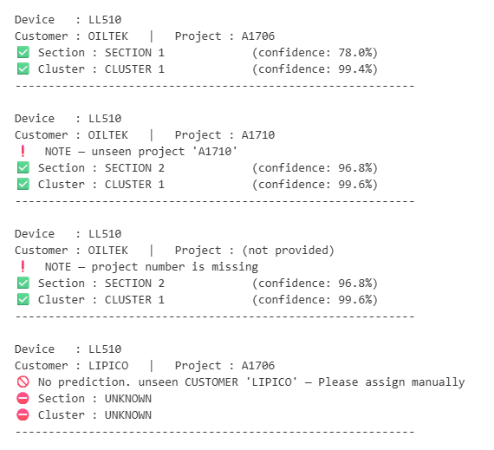

Slide 16
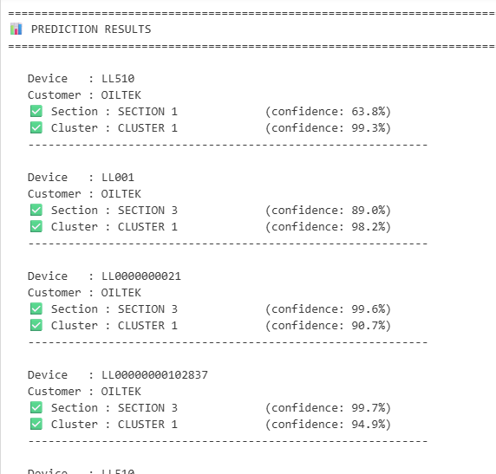
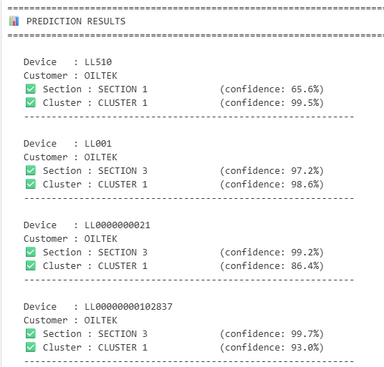

Slide 17
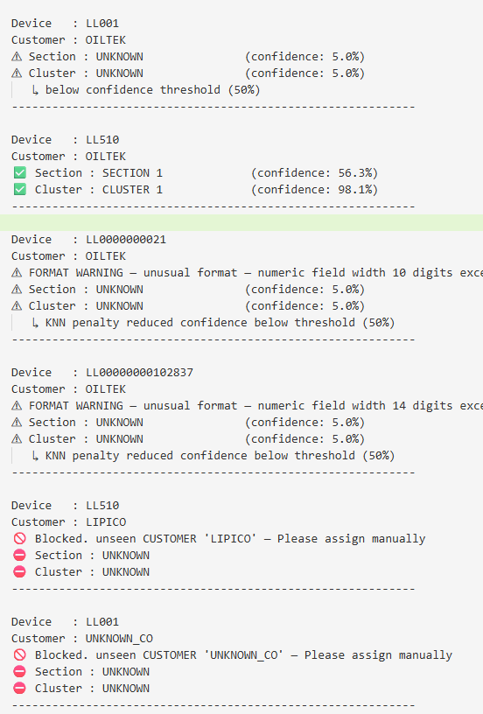
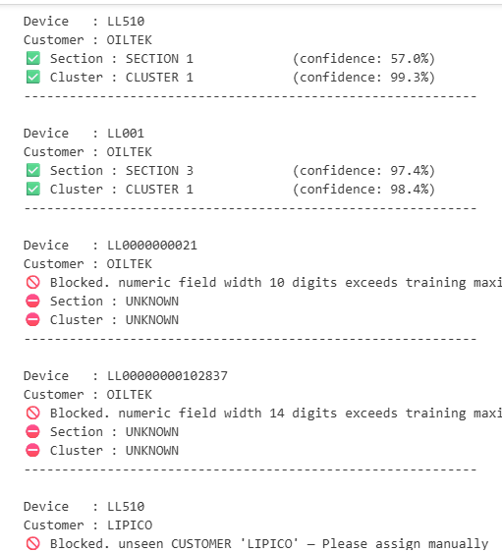

Slide 18
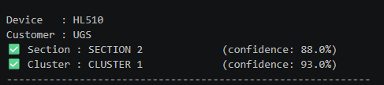
Flag this. Solved the problem
Training script — Step 3: Add le_shape to the save cell.
Edit Notebook Cell C:\Users\sitisyaziyah\source\repos\DeviceCluster\1.training_model\Section XGB Model - Model Training.ipynb:a3380379
Success

Slide 19
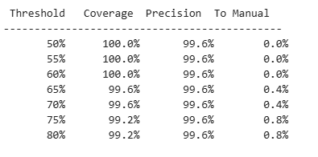
Threshold sensitivity test

Slide 20
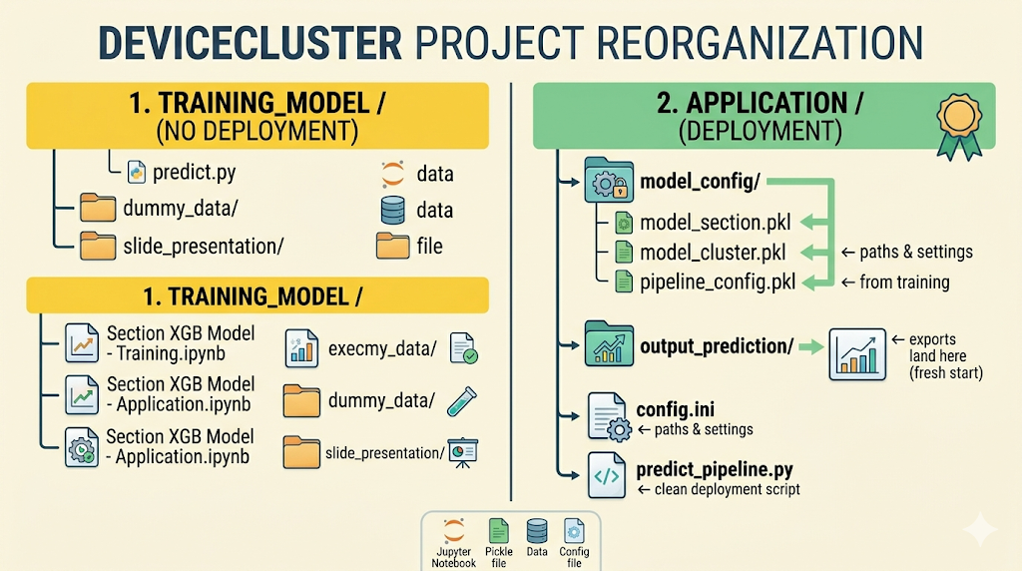

Slide 21
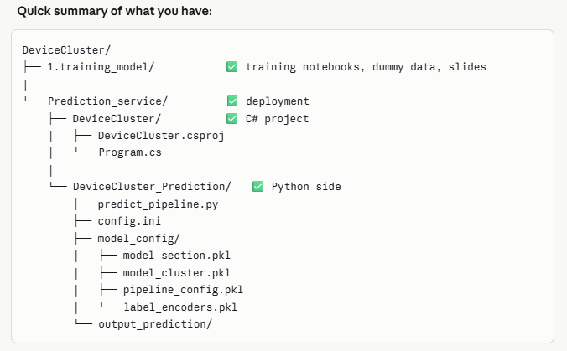

Slide 22
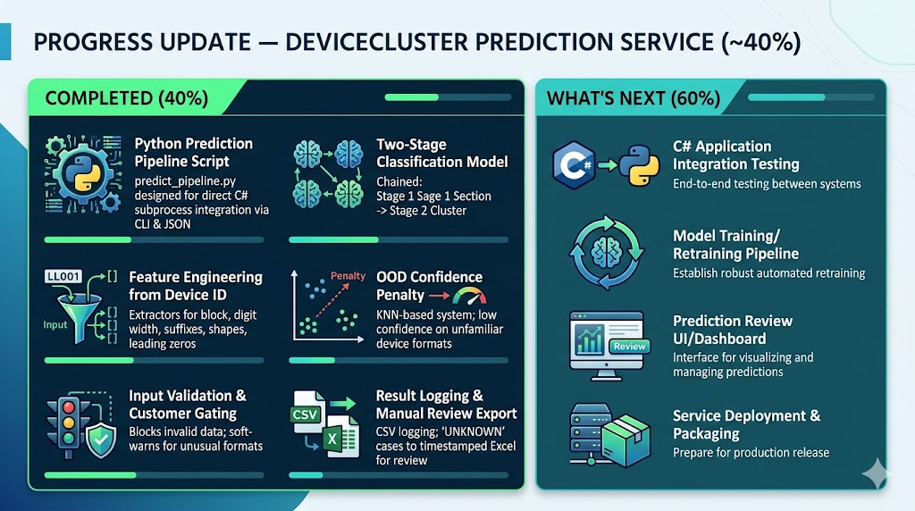

Slide 23
MACHINE LEARNING PIPELINE
INPUT
(Customer, Project, Device ID)
UPDATE ON (16.04.2026)
1
Load Data
[new_equipment.pkl]
ML MODEL
XGBoost
3
NEW EQUIPMENT DATA
Cluster
UNKNOWN
= Assigned by User
Section
2
RESULT OUTPUT
(Customer, Project, Device ID, Section, Cluster)
Process flow
(1) Input - Model – Result Output – Update & Save Model
(2) Input - Model - Output (UNKNOWN) - Assign by user – New Equipment Data
- Model – Update & Save Model
(3) New Equipment Data - Model - Update & Save Model
UPDATE & SAVE MODEL

Slide 24
MACHINE LEARNING PIPELINE
INPUT
(Customer, Project, Device ID)
UPDATE ON (16.04.2026)
RETRIVE
[new_equipment.pkl]
NEW LIST OF EQUIPMENT
ML MODEL
XGBoost
Cluster
Section
UNKNOWN
= Assign by User
RESULT OUTPUT
(Customer, Project, Device ID, Section, Cluster)
UPDATE & SAVE MODEL

Slide 25
UPDATE ON (16.04.2026)

Slide 26
Proof Of Concept (POC)
Problem Understanding
Objective | Produce a model of device identifier that can predict the section and cluster
What to Predict/Target? | Section and Cluster
Data Setup | Structured dataset
Number of column | 5 (CUSTOMER, PROJECT, DEVICE ID, SECTION, CLUSTER)
Method? | Supervised Machine Learning - Classification
Model Name | XGBoost
Data Availability | Oiltek – 6 project (2 real data + 4 dummy) UGS – 6 project (2 real data + 4 dummy)
Key findings | Is the model able to predict correctly?

Slide 27
DATASET

Slide 28
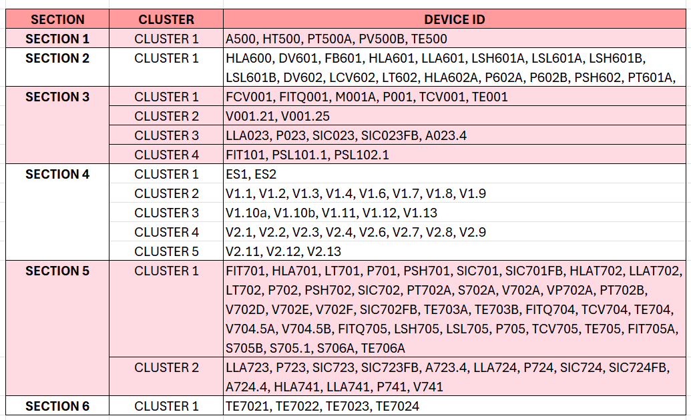
OILTEK – USING IN TRAINING
PROJECT : A1706
CUSTOMER : OILTEK
TOTAL DEVICE : 130
Filepath : "C:\Users\sitisyaziyah\Documents\Device_Identifier\Dummy data\Oiltek - structured data.xlsx“

Slide 29
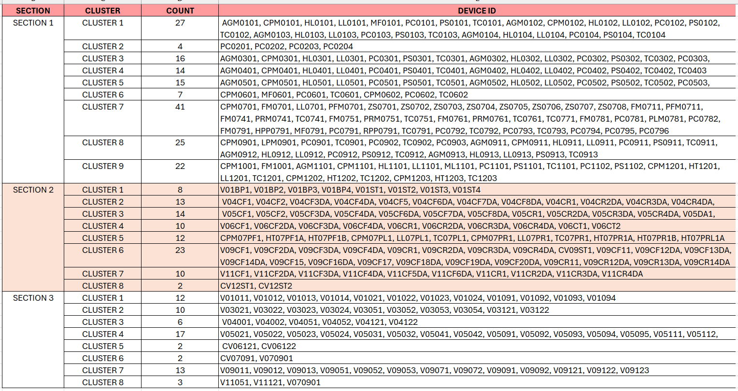
UGS – DROPOUT IN TRAINING. THE PATTERN NO LONGER USED ANYMORE
CUSTOMER : UGS PROJECT: A2027 TOTAL DEVICE : 328
Filepath : "C:\Users\sitisyaziyah\Documents\Device_Identifier\Dummy data\UGS - structured data.xlsx“ (sheet = A2027-S2)

Slide 30
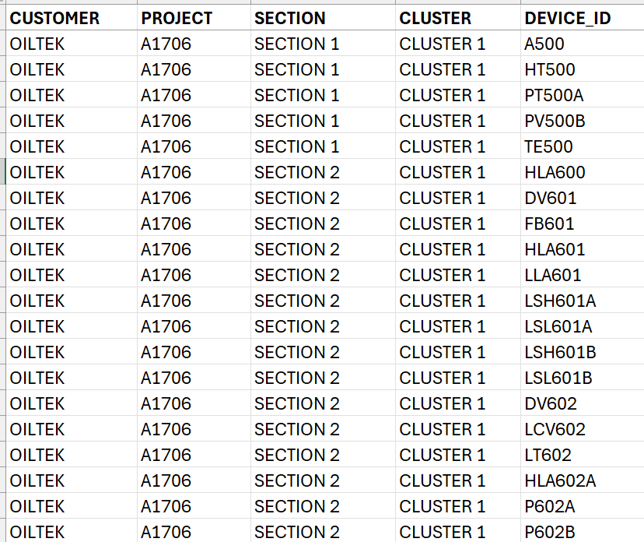
PROJECT : A1706
CUSTOMER : OILTEK
FORMAT DATASET TO LOAD
Filepath : "C:\Users\sitisyaziyah\Documents\Device_Identifier\Dummy data\Oiltek - structured data.xlsx“ (sheet = A1076_df)

Slide 31
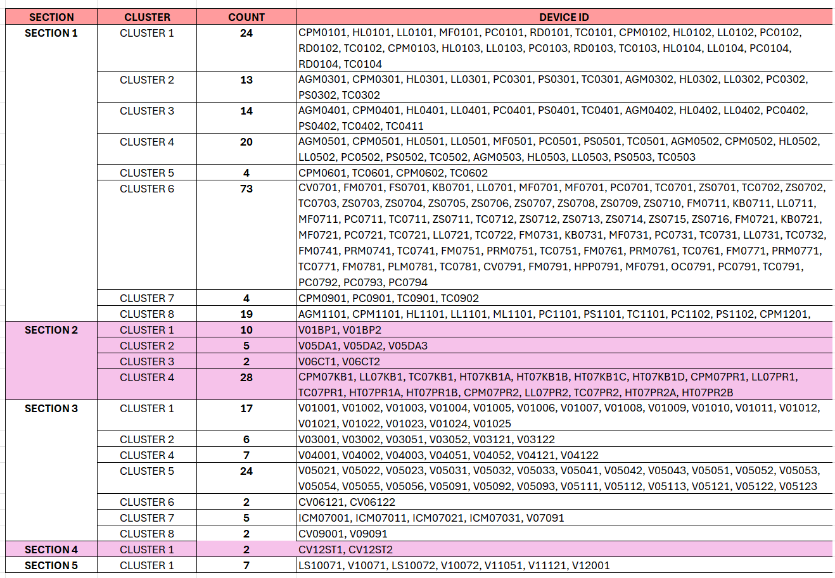
CUSTOMER : UGS PROJECT: A1887 TOTAL DEVICE : 286
Note 16/4/2026
DROPOUT OILTEK_A1827
UGS_A1887
Filepath : "C:\Users\sitisyaziyah\Documents\Device_Identifier\Dummy data\UGS - structured data.xlsx“ (sheet = A1887-S2)

